Slide 1
Matching Engine
Noah Sivinski

Slide 2
Background
A matching engine is a software program that matches buy and sell orders for a stock exchange
Accepts a series of limit orders and either fills them immediately if there is a matching order, or adds them to the order book if there is not
Electronic exchanges use a matching engine to facilitate price discovery and matching of buy and sell orders
The matching engine sits at the core of the exchange, maintaining order books for the assets traded on the exchange

Slide 3
Creation
To create a matching engine, we can use a variety of data structures and algorithms to manage the order book and fill orders
Some common data structures for managing the order book include linked lists, binary trees, priority queues, heaps, etc.
These data structures can be used to efficiently store and retrieve orders from the order book.
Additionally, we can use metrics such as average time an order is fulfilled to evaluate the performance of the matching engine
By tracking this metric, we can identify areas for improvement and make changes to the algorithm to optimize the engine's performance

Slide 4
Algorithms
First-in-first-out (FIFO)
Pro Rata
Random
Most satisfied customers

Slide 5
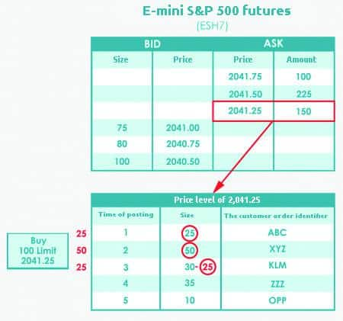
First-In-First-Out
First-in-first-out (FIFO) is a simple algorithm that fills orders in the order that they are received. This means that the first order received is the first one to be filled.
The limit order, which is posted in the order book earlier than others, takes the highest priority among other orders, which are at the same price level, in the process of matching with the incoming aggressive orders.

Slide 6
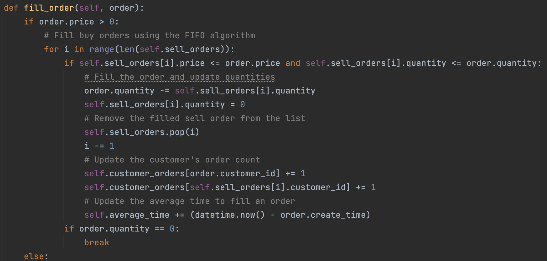
Fill Order Method

Slide 7
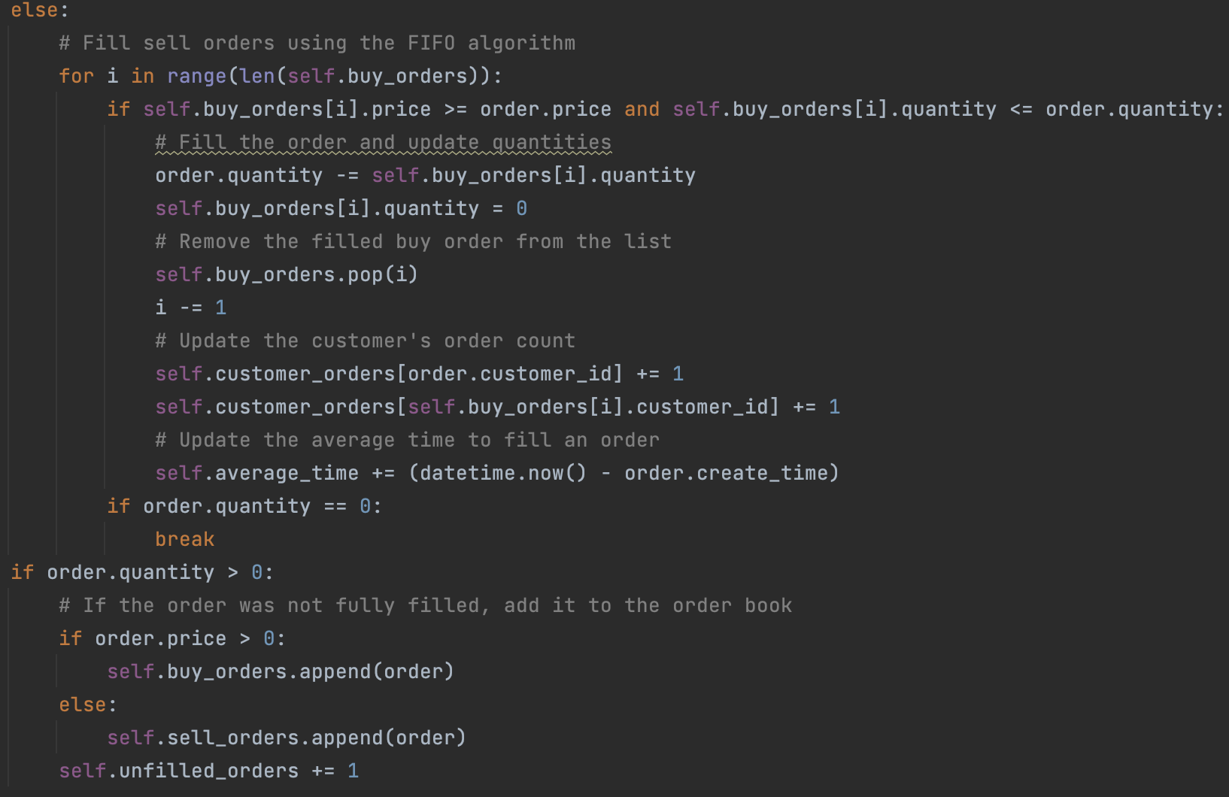

Slide 8
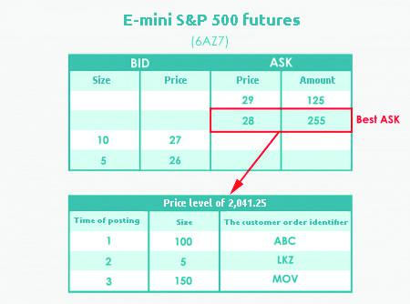
Pro Rata
Execution principle taking into account only the price or, respectively, the limit price of the orders in the order book, and not the usual price/time priority
As soon as new orders are entered into the trading system, it searches the order book and automatically executes matching orders in proportion to the orders contained in the order book

Slide 9
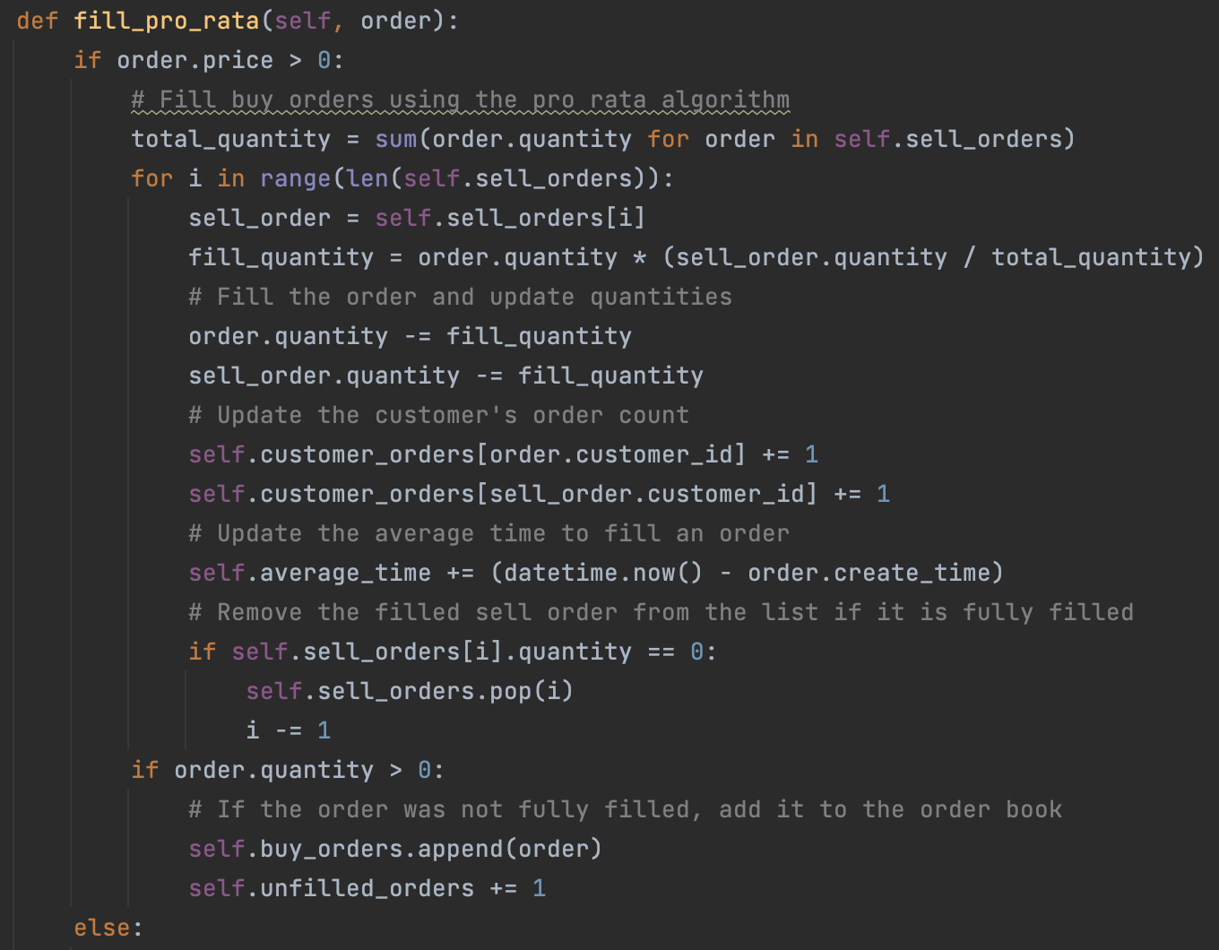

Slide 10
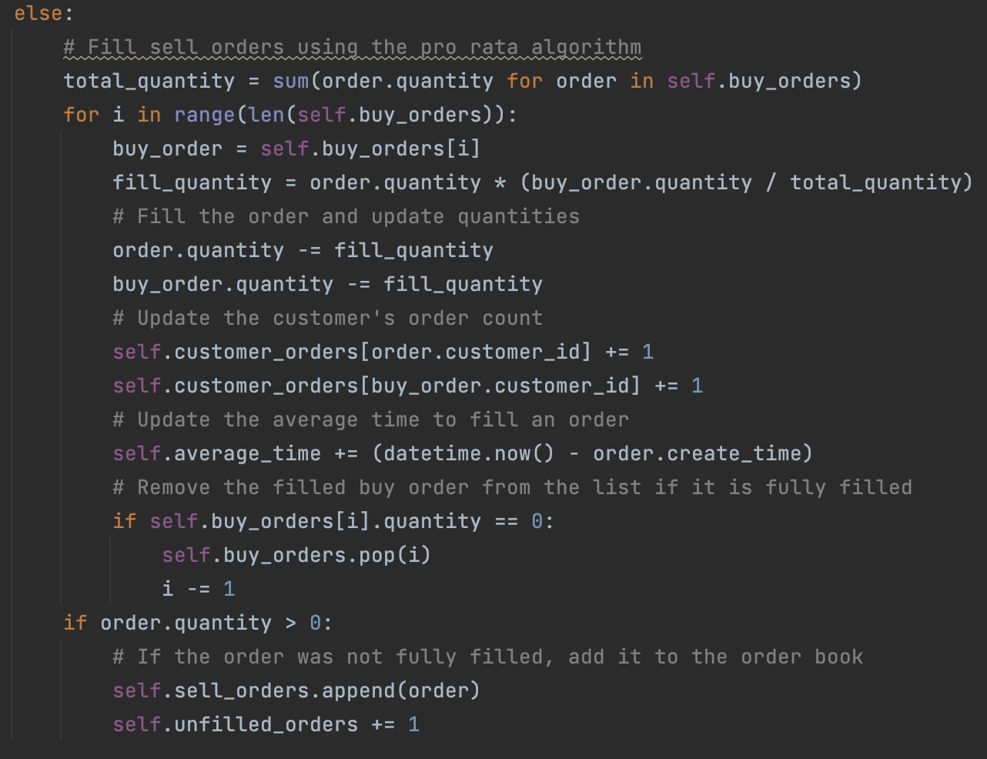

Slide 11
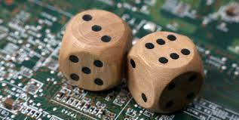
Random
Random is another simple algorithm that fills orders randomly. This means that orders are filled in a random order, rather than in the order that they are received.

Slide 12
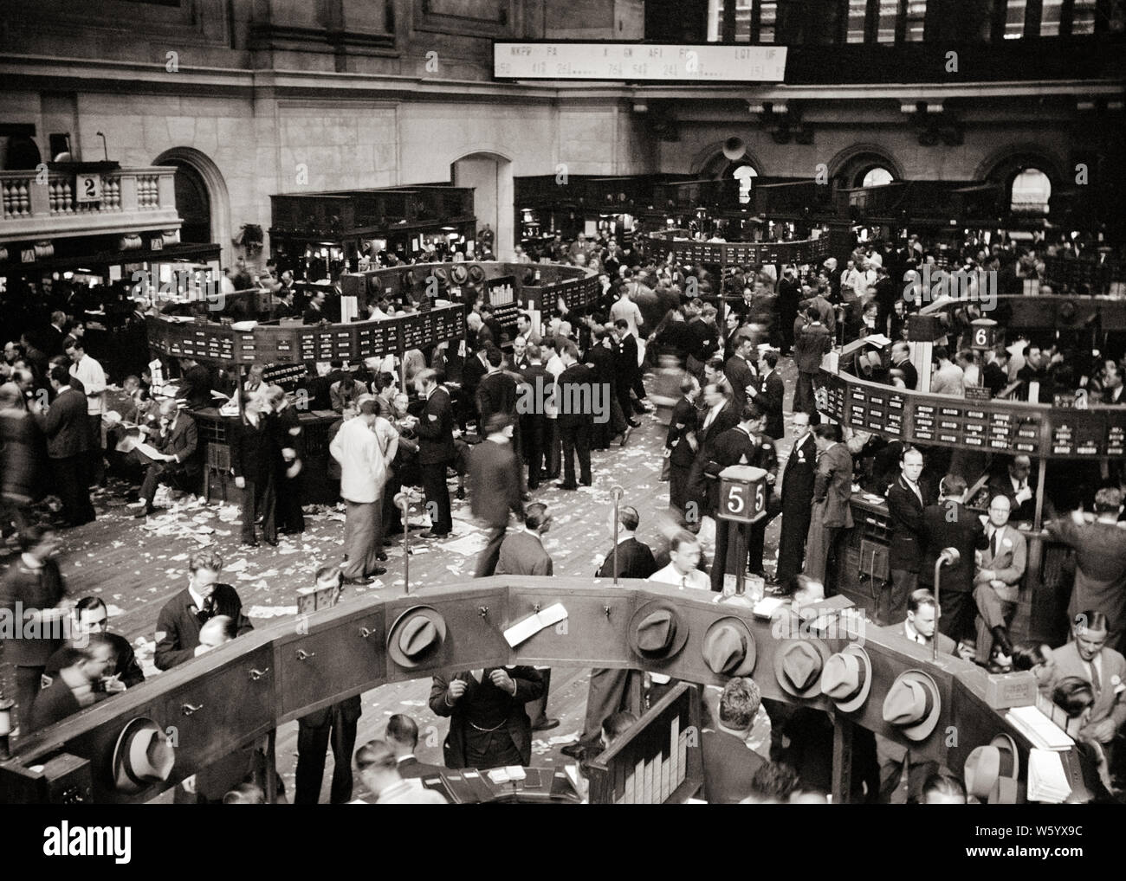
Most Satisfied Customers
Most satisfied customers is an algorithm that prioritizes filling orders from customers who have had their orders filled the least number of times
Can help to ensure that all customers are treated fairly and that orders are filled in a way that maximizes customer satisfaction.

Slide 13
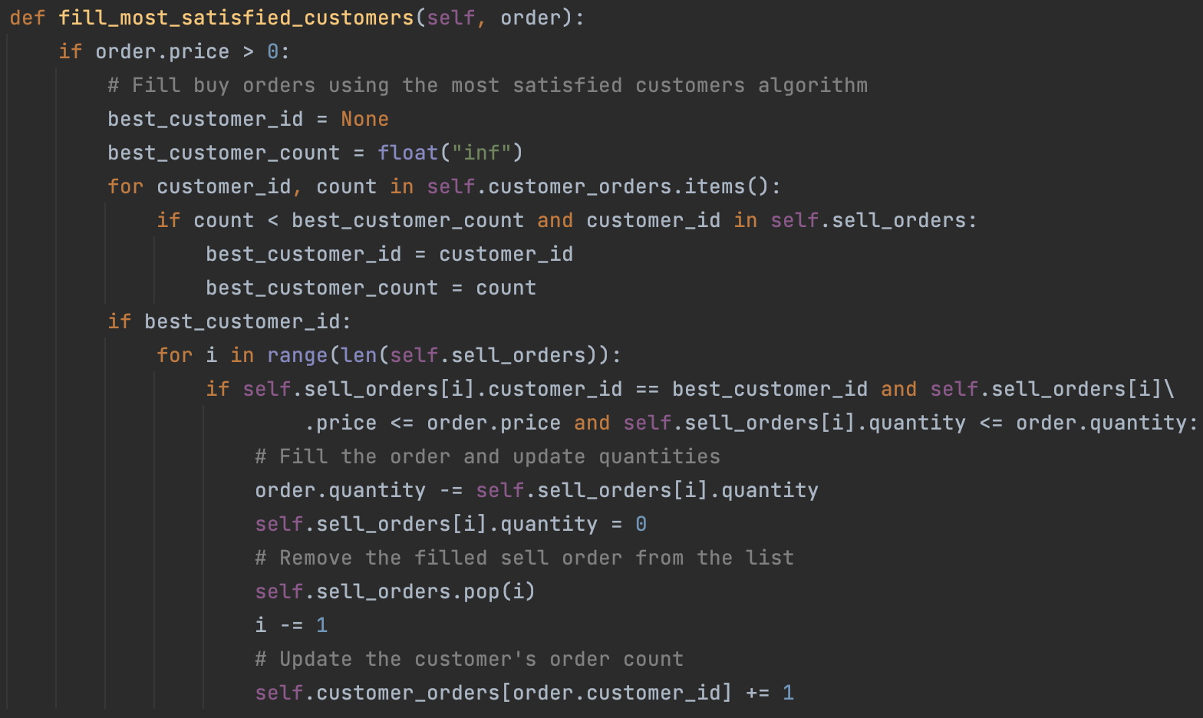

Slide 14
Engine

Slide 15
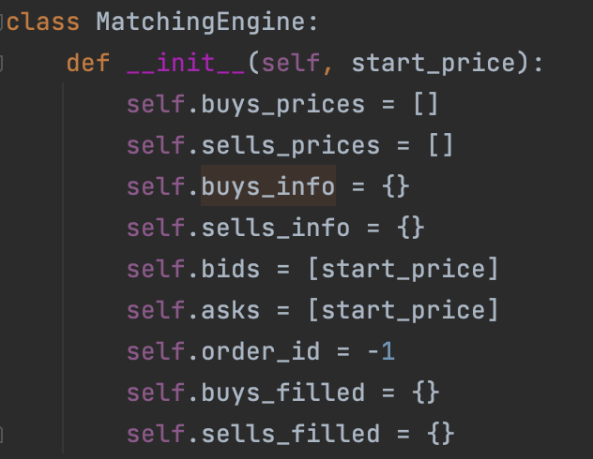

Slide 16
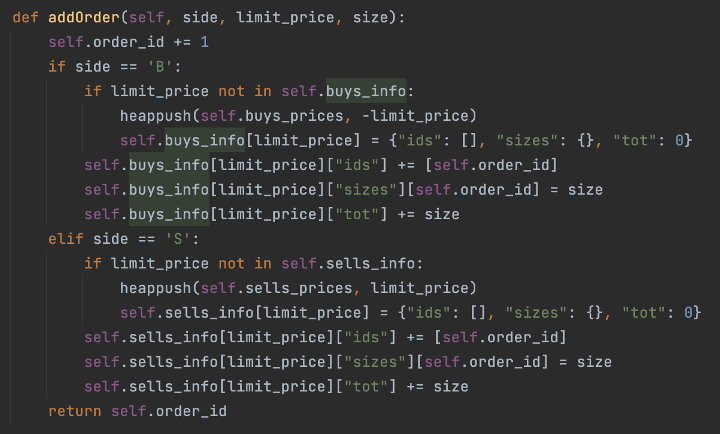

Slide 17
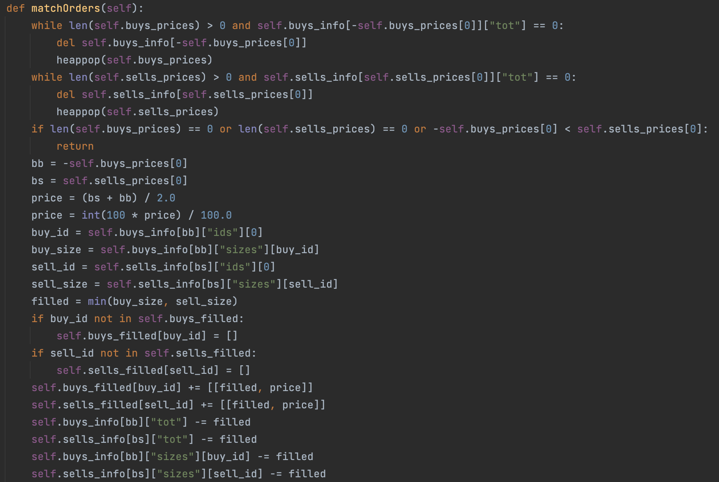

Slide 18
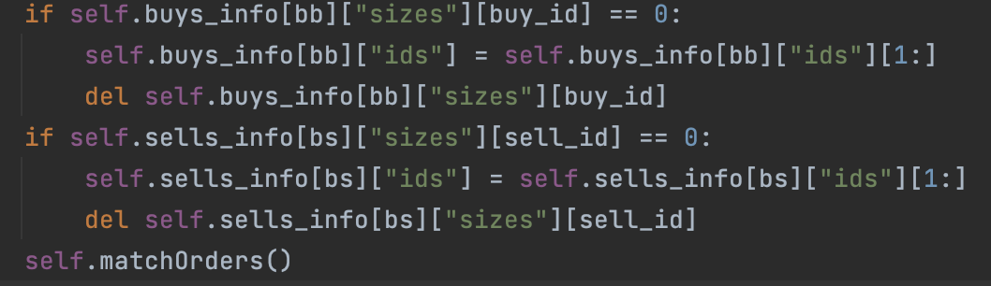

Slide 19
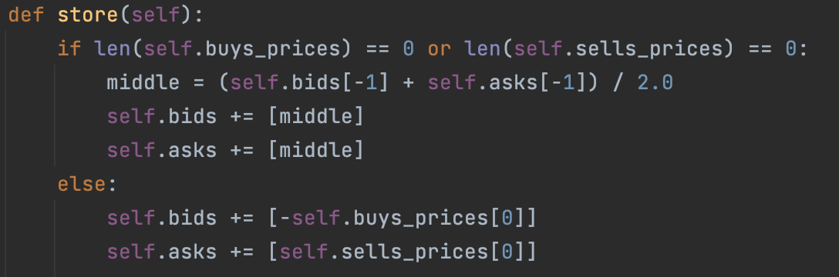
Storing Prices

Slide 20
Testing the Engine

Slide 21
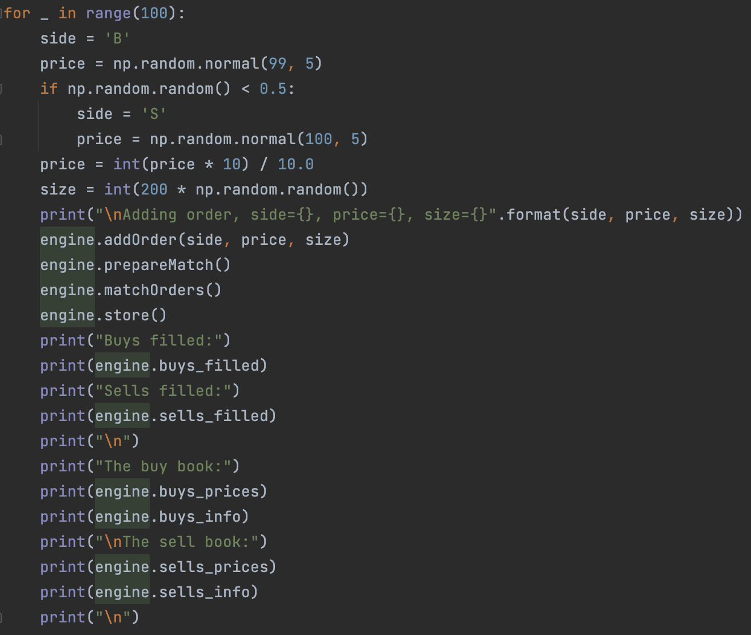

Slide 22
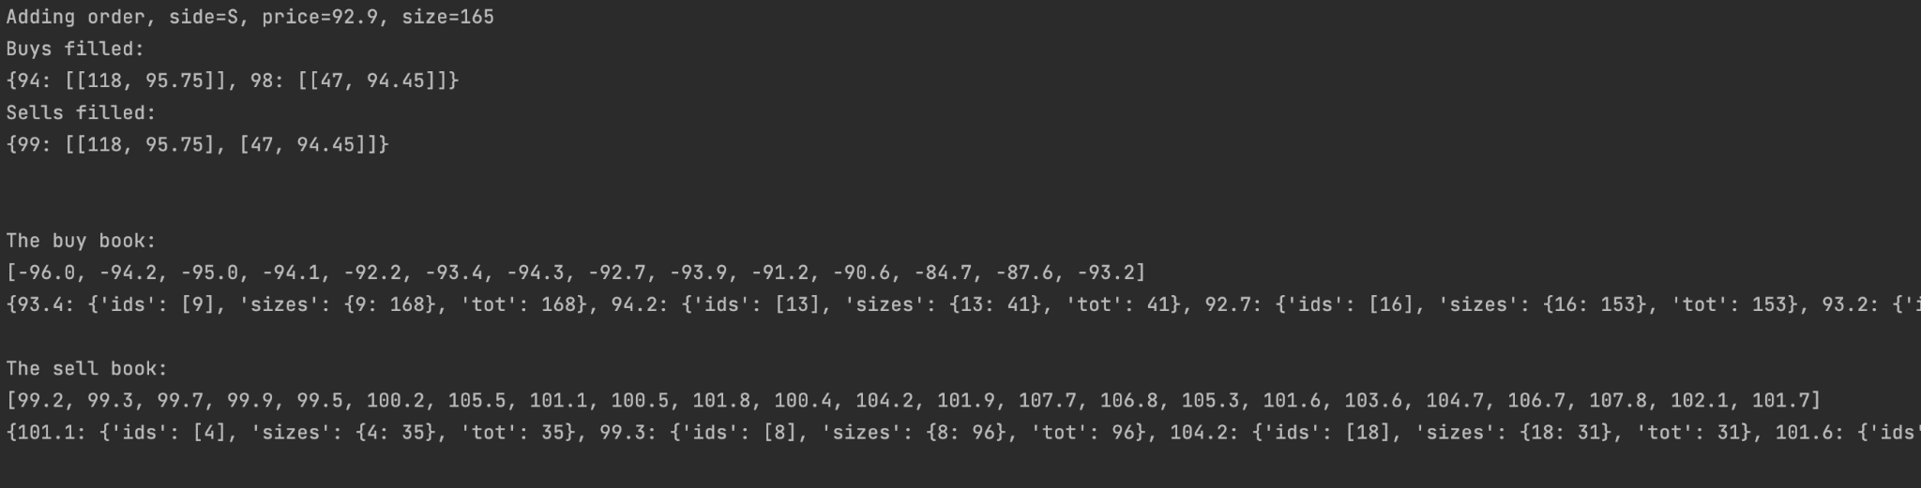
Example Output

Slide 23
Plots

Slide 24
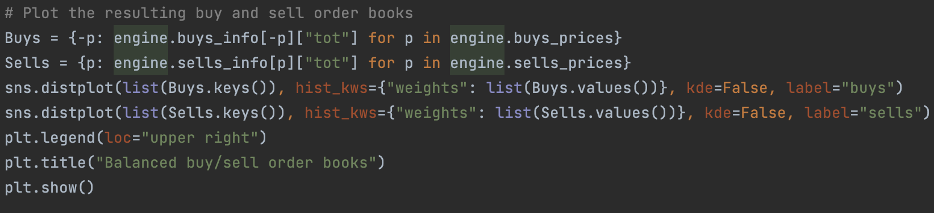

Slide 25
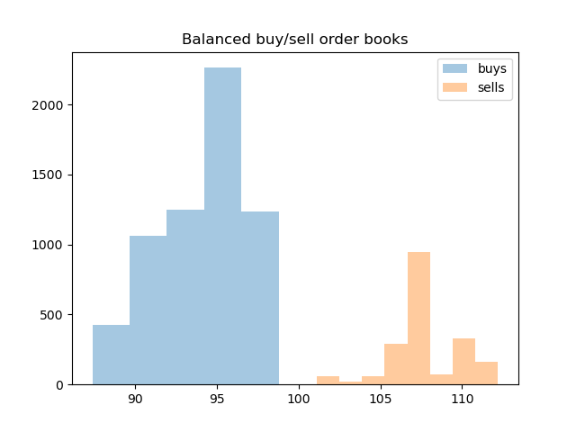

Slide 26
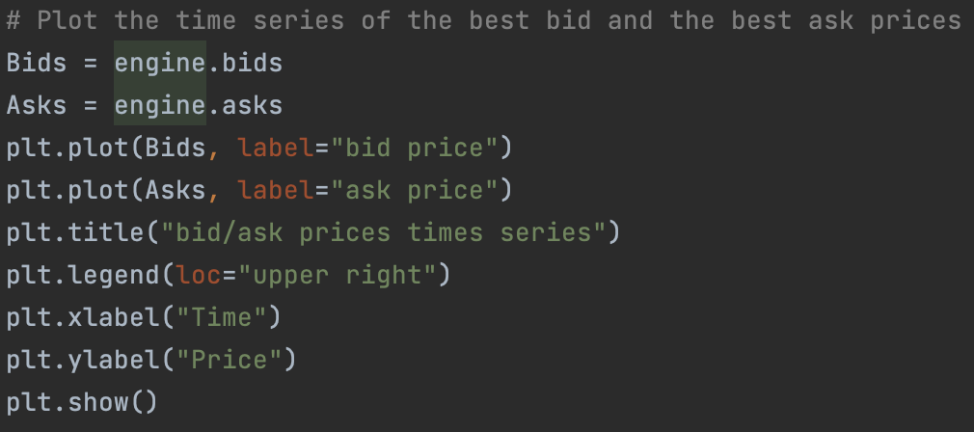

Slide 27
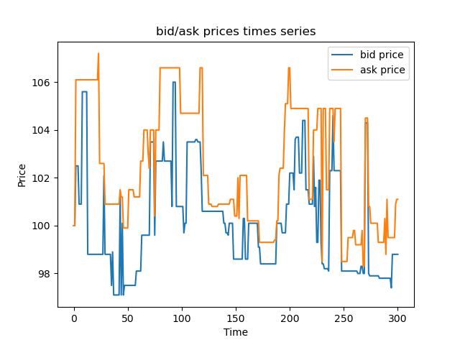

Slide 28
Questions?

Slide 29
Thanks!

